Slide 1
New CPD Modules MA Advanced Professional Practice

Slide 4
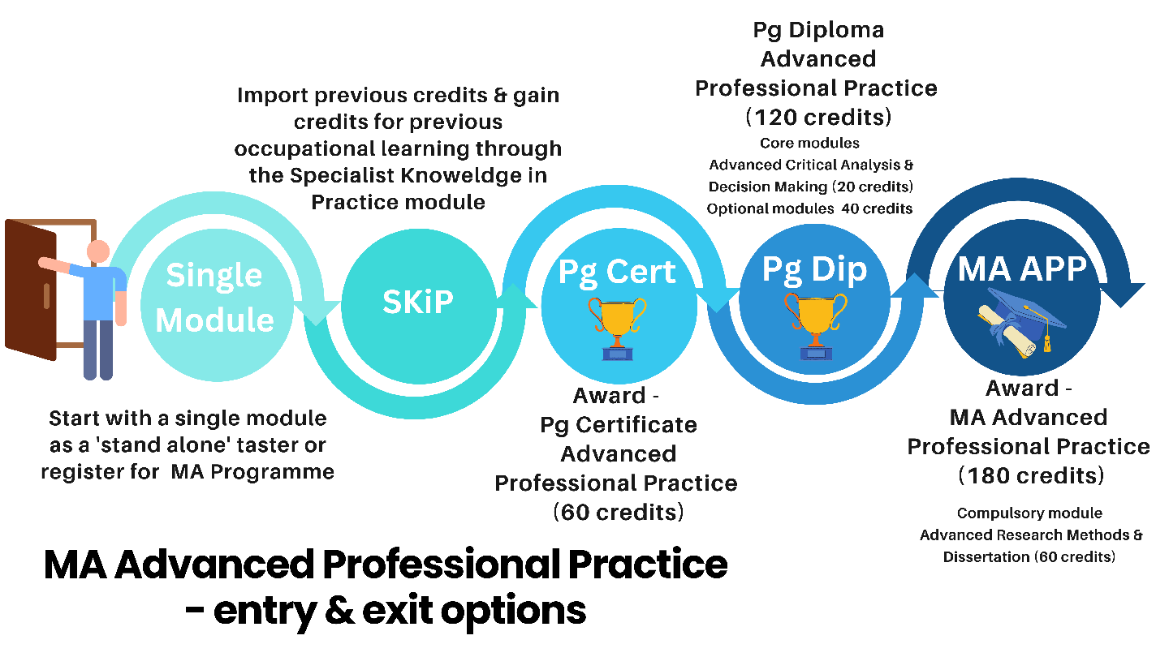

Slide 7
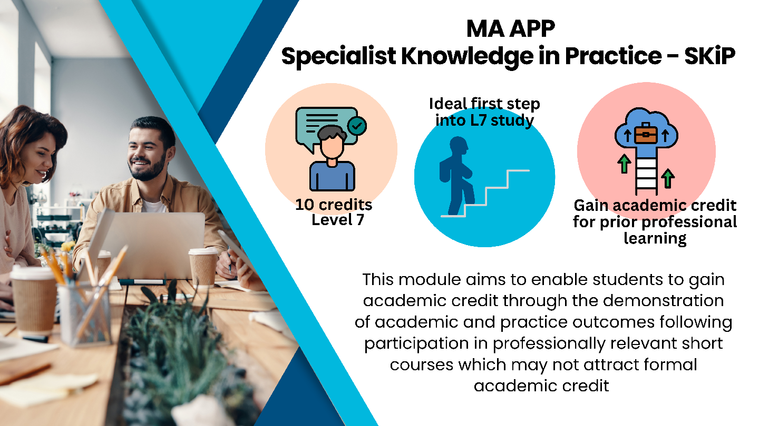

Slide 10
